Slide 1

Games Research & Development Block 03 – Week 02

Slide 2



HAVE YOUR SAY
The Postgraduate Taught Experience Survey (PTES) is your chance to have your say about your experiences at UWE Bristol.
Results are used to improve your programme and the University
as a whole.
THANKS
Complete the survey today at: https://uwe.onlinesurveys.ac.uk/ptes2018

Slide 3

THIS WEEK
Video / Demo
One-on-One Meetings

Slide 4
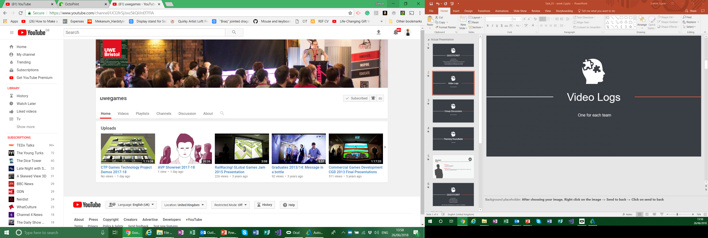
Video Logs
Place your screenshot here
Unlisted YouTube video.
I’ll add them to this years play list later!
If you think you made something pretty enough
+ TWEET + @UWEGamesMSc

Slide 5
DEMOS!
Place your screenshot here

Slide 6

One-On-One Meetings
Prod about plan
Documentation
How’s the write up going?

Slide 7
NEXT WEEK
Video / Demo
One-on-One Meetings

Slide 8
Any questions?

